Slide 1

Fingerprinting on the Web
Preethi Josephina Mudialba, Siddharth Nair, Jun Ma

Slide 2
Problem Statement
Combine FPBlock and AdFisher
Determine: significant evidence that fingerprinting occurs on web services.

Slide 3

Fingerprinting
Fingerprinting : exploits the difference in the browser characteristics rendered.
Brower characteristics which may seem trivial such as screen dimensions, installed fonts, browser plugins, browser version number etc, can be combined to create a unique ID, which can be used to track a user, in other words a browser fingerprint is created and used to uniquely identify a user.

Slide 4

Related Work:
Mowery and Shacham's paper
Possible methods by which the occurrence of finger printing can be prevented :
Addition of noise to the pixel data or production of the same pixel for every single system – Not faultless.
Best solution : ask user permission for each canvas read attempt.
Ghostery, PrivacyBAdger, AdBlock Plus, DuckDuckGo
Notes:
Picture from : https://commons.wikimedia.org/wiki/File:Tor_logo-1.png

Slide 5
Ad Fisher
An automated tool that works by sending out hundreds or thousands of automated Web browsers on carefully chosen trails across the Web
Allows ad-targeting networks to infer certain interests or activities. [10].
Prototype browser extension that detects and prevents the occurrence of web-based device fingerprinting.[11].
Currently FP-Block just runs on version 45 of Mozilla Firefox.
FP Block

Slide 6
Experimental results
FP-Block runs only on Mozilla Firefox 45.
Integrated FP-Block with the AdFisher tool.
Data collected by FP-Block is fed to AdFisher for analysis.
Analyzed the code of Ad Fisher and compiled the FP Block into an extension file that can be installed on Mozilla Firefox 45.
Successfully modified the existing Ad Fisher script so that we could control the instances in which FP Block would launch as a part of the browser with the help of Selenium.

Slide 7
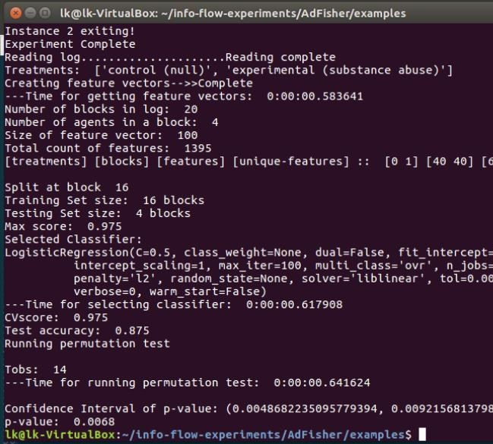
Integration: Ad Fisher + FP Block
Modified the test_substance.py script, so that in the Control and Experimental groups, two units of the browser instance without FP Block and two units with FP Block would be launched.
Collected ads from both the groups and analysed them, and received a significant p-value(0.0068), indicating that the ads served were indeed different for the same websites.

Slide 8
Analysis
With/Without FP Block | No of Units | Site Category Visited | Site Collected Ads from | Test Accuracy | p-value
W | 2 | Electronic Products | bbc.com/news | 0.9375 | 0.0001
W | 2 | Drugs & Medications | usatoday.com | 0.75 | 0.0405
W | 2 | Watches | usatoday.com | 0.6875 | 0.1647
W | 2 | Cars | bbc.com/news | 1.0 | 0.0009
W | 2 | Cars | usatoday.com | 0.4375 | 0.9163
W | 2 | Substance Abuse | bbc.com/news | 1.0 | 0.0006
W/O | 4 | Substance Abuse | bbc.com/news | 0.625 | 0.2558

Slide 9
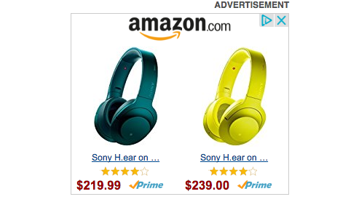
Future Work & Conclusion
Future Work:
Use Ghostery to block individual trackers.
Test it between websites with common trackers.
Conclusion:
From the results obtained we conclude that there is statistically significant evidence that fingerprinting occurs on certain major web services.

